Slide 1

New MOWIDEC centering unit for Star
Easy centering and setting system

Slide 2
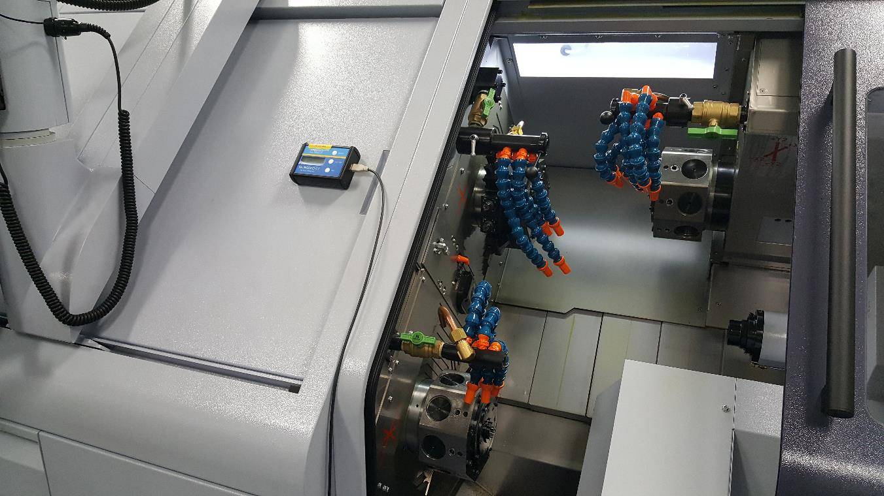
The display unit is mounted on the machine with a built in magnet. It is powered by rechargeable battery and the sensor plugs into the unit with a USB connection.

Slide 3
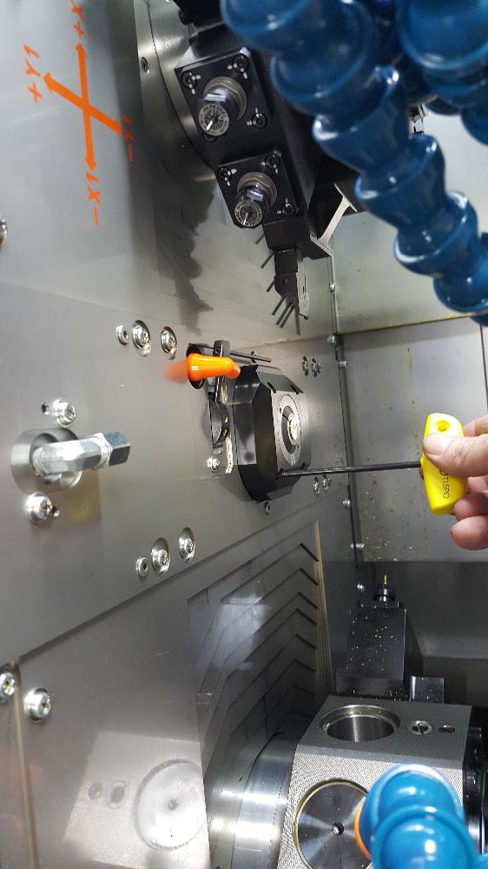
Remove the splash cover of the guide bushing to reveal the outside diameter of the sleeve.

Slide 4
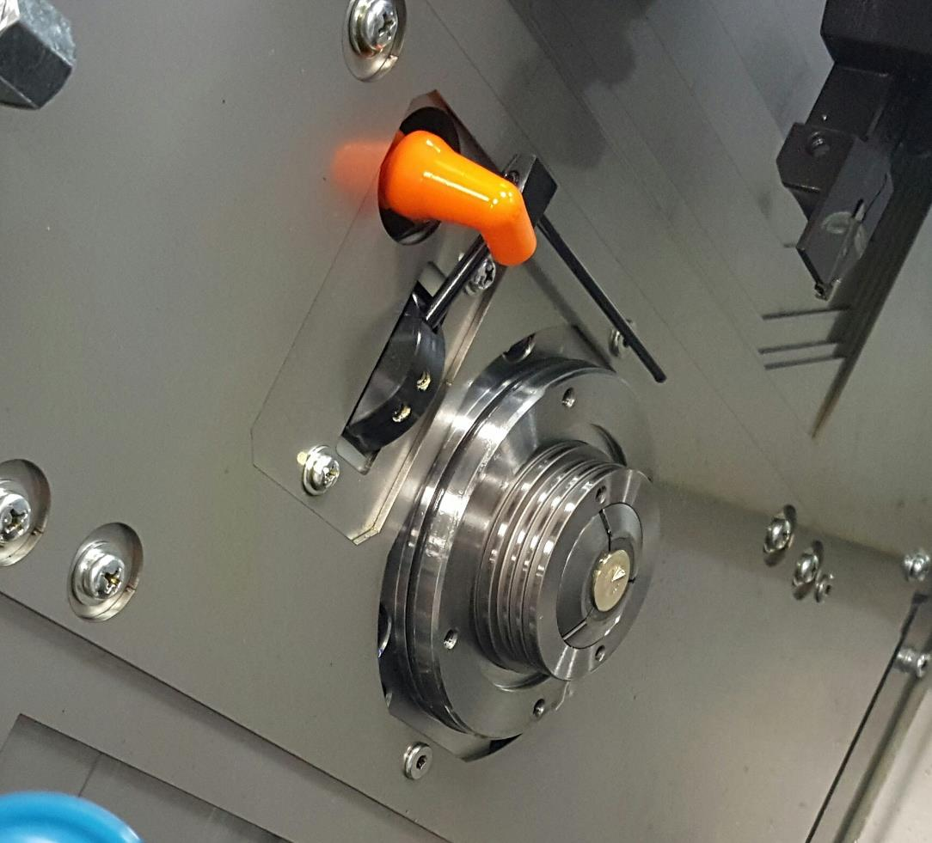
This is where the sensor ring will mount.

Slide 5
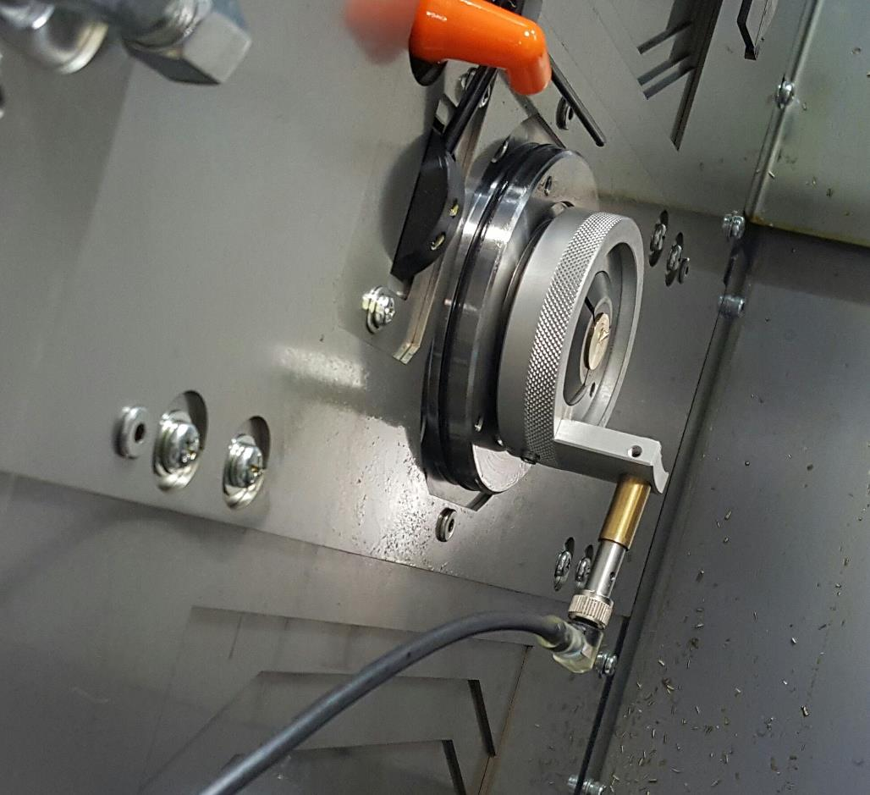
The sensor ring is installed with a set screw. This ring also fits the outside of the sub spindle cap. The sensor is in a brass sleeve and held in place by set screws. Never tighten the set screws against the sensor without the brass sleeve. Tighten the set screws enough against the sleeve so that the sensor is held solid.

Slide 6
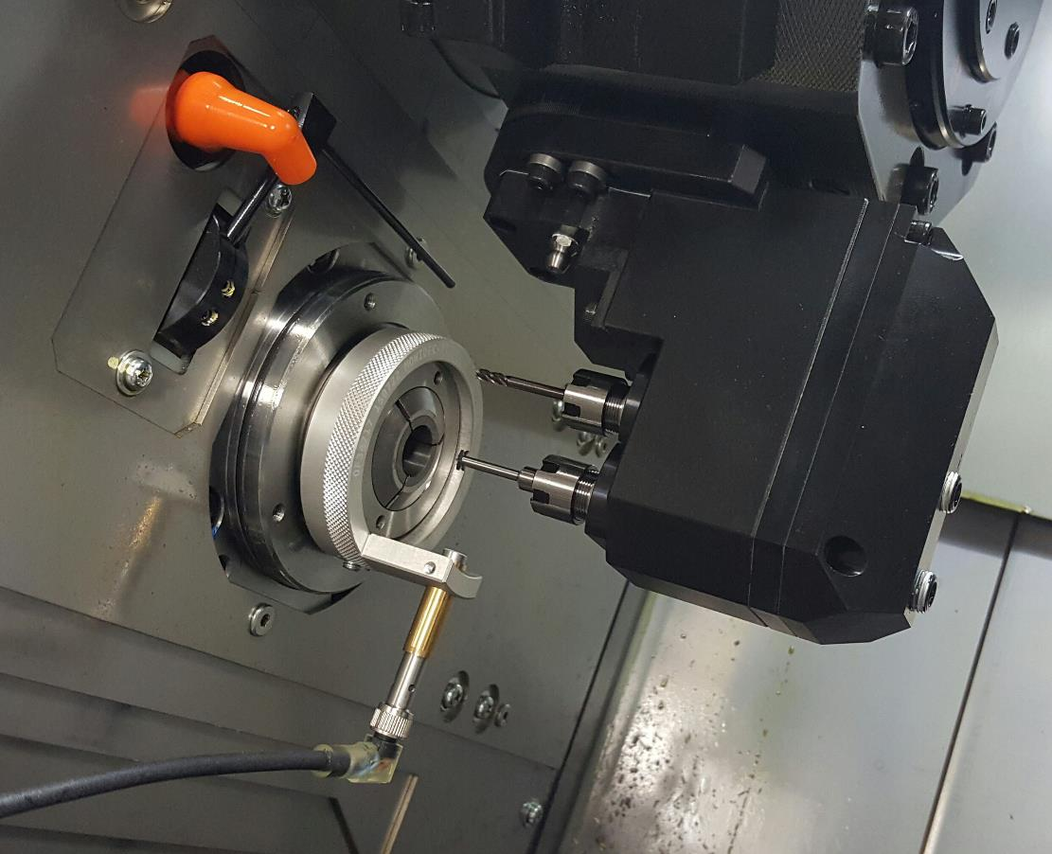
Select the tool and bring it to its center position. In this case, the double tool stations will prevent 360° rotation of the sensor, but this will not be a problem as only 3 measurements are needed to perform the centering. This is true of traditional test indicators, but this sensor is easy to install, easy to ZERO, and does not require removal of the bushing collet. Fixturing a traditional test indicator would be impossible in this space.

Slide 7
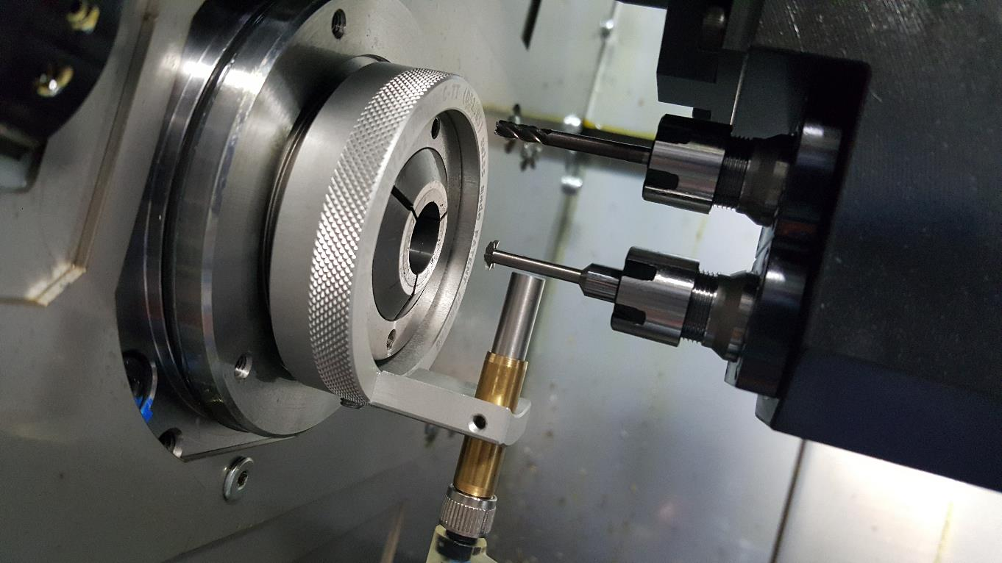
Adjust the sensor toward the tool until it is about 1mm to .5mm from the tool – the display unit will begin to display values when the sensor is close enough to read. This is a good time to check the runout of the tool; the display shows real time data. If there is some runout, remove it physically if possible, or rotate the tool to where the high spot is either vertical or horizontal and take it into account when making adjustments.

Slide 8
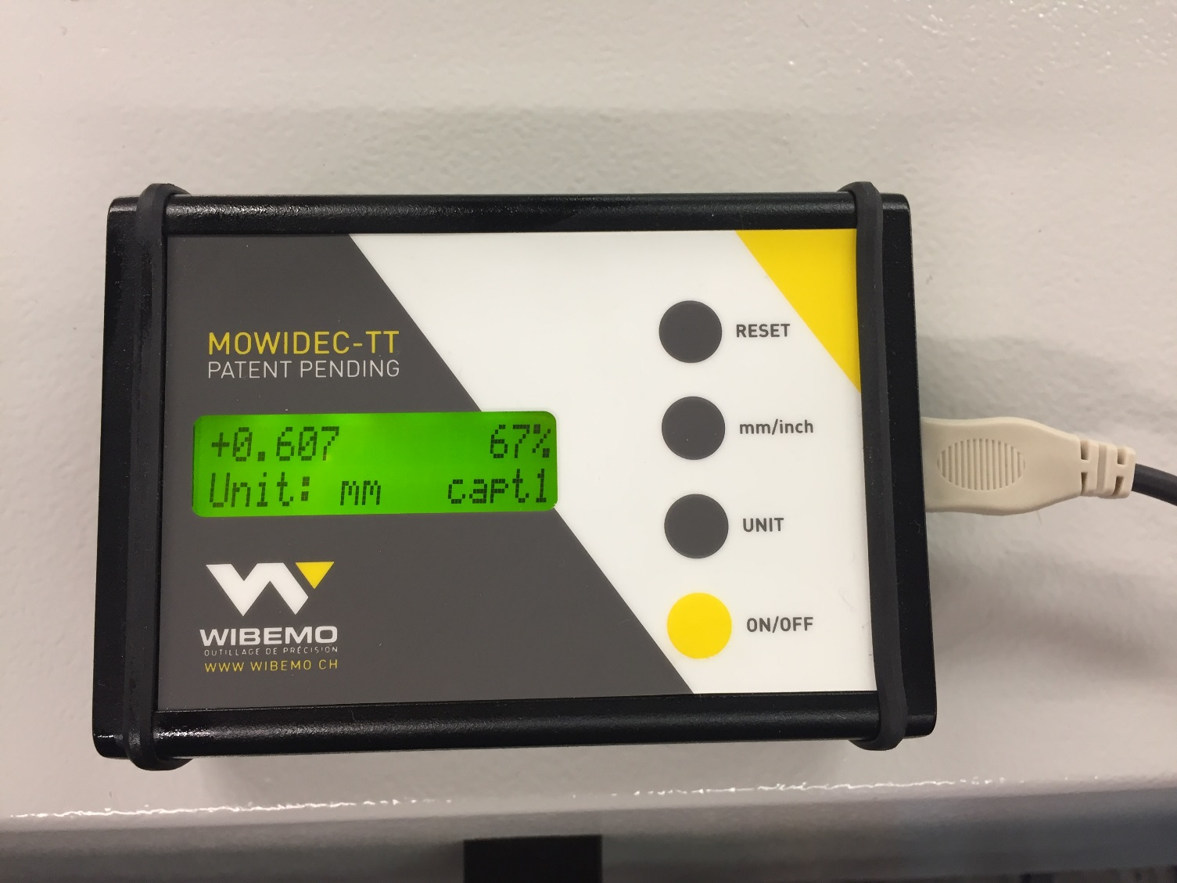
The unit will initially display some large value in mm.

Slide 9
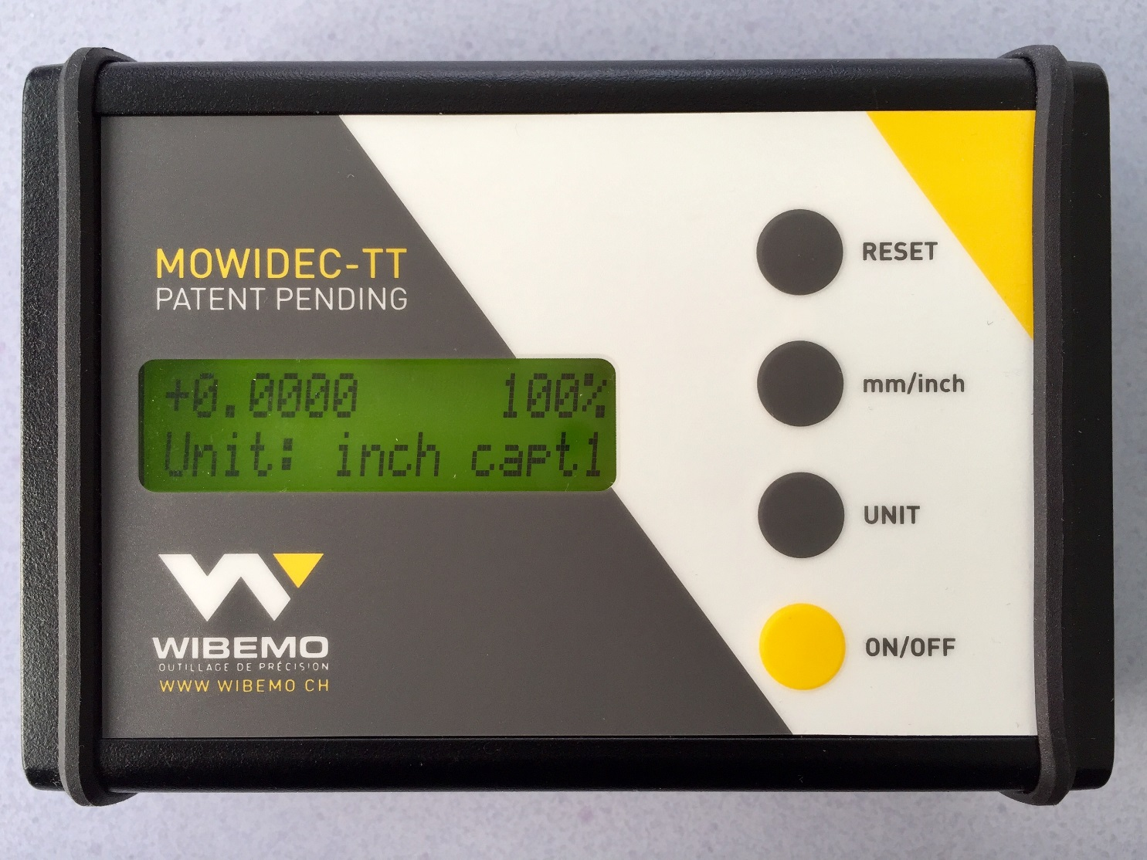
Press the mm / inch button to switch to inch display if needed.

Slide 10
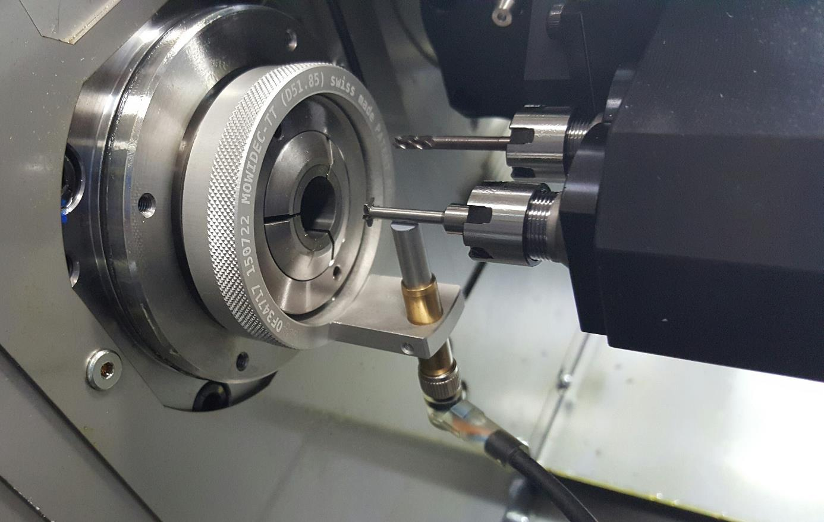
Rotate the sensor to the bottom vertical centerline measuring position.

Slide 11
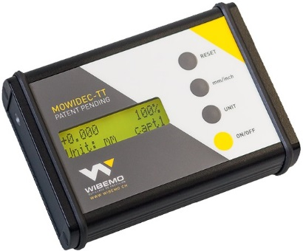
Press RESET to zero the display at this position.

Slide 12
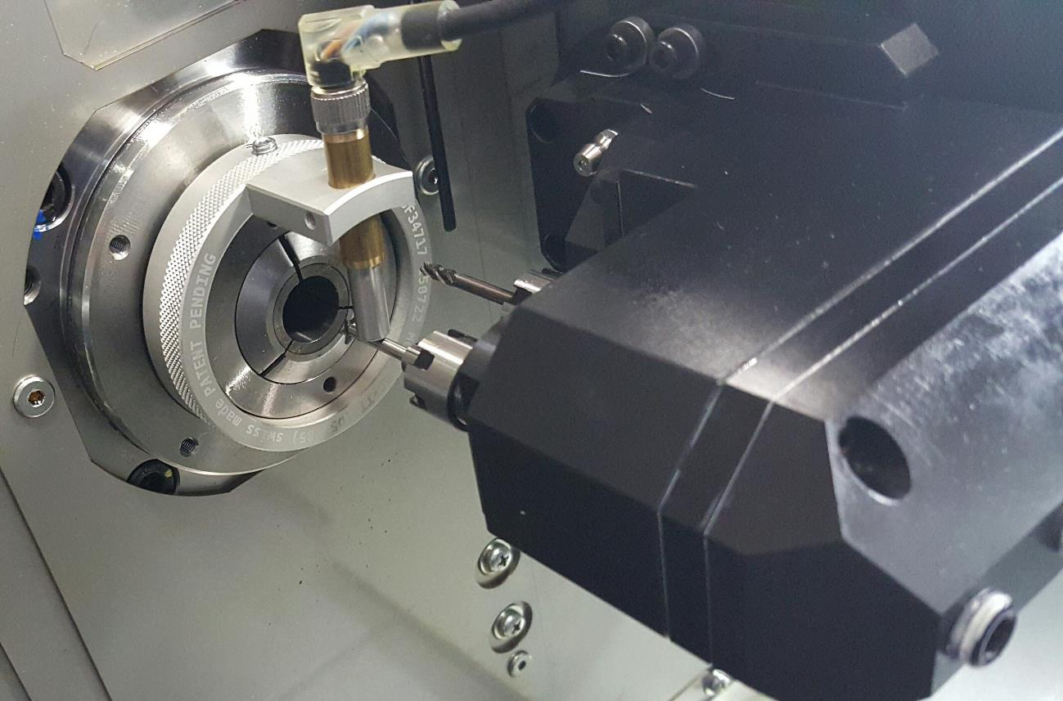
Rotate the sensor to the top vertical centerline measuring position.

Slide 13
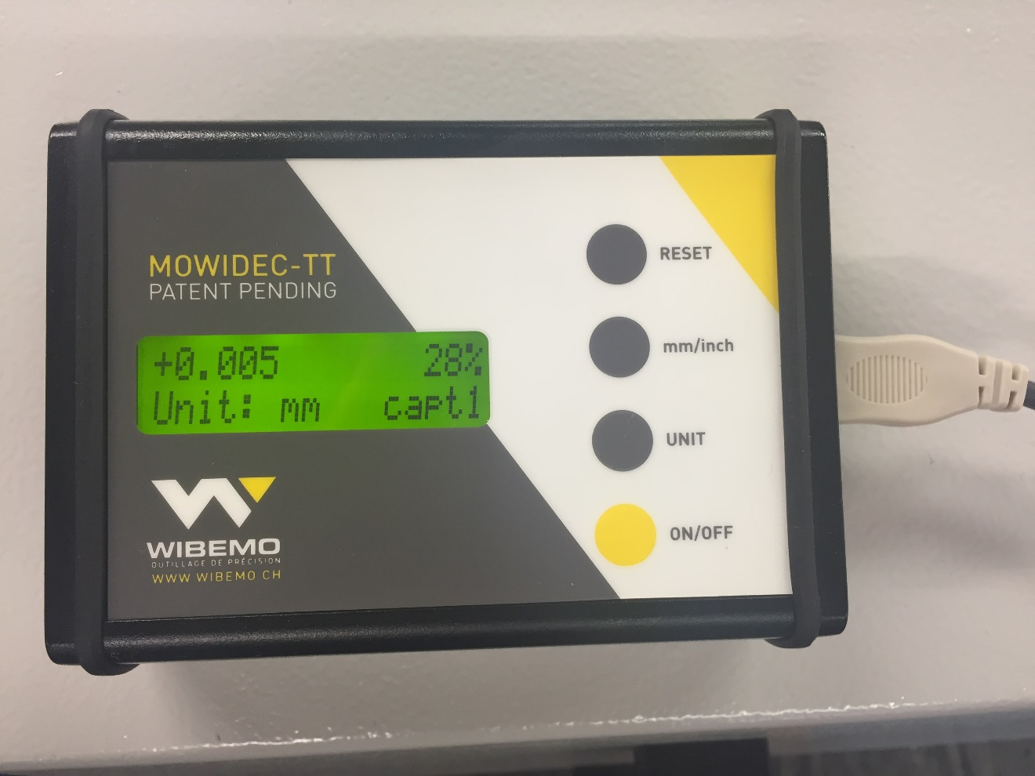
The display will now show the deviation for the vertical centerline. In our case the value was 0, but if there were a value, move the vertical axis half the displayed amount to bring the tool to the vertical centerline, and check again.

Slide 14
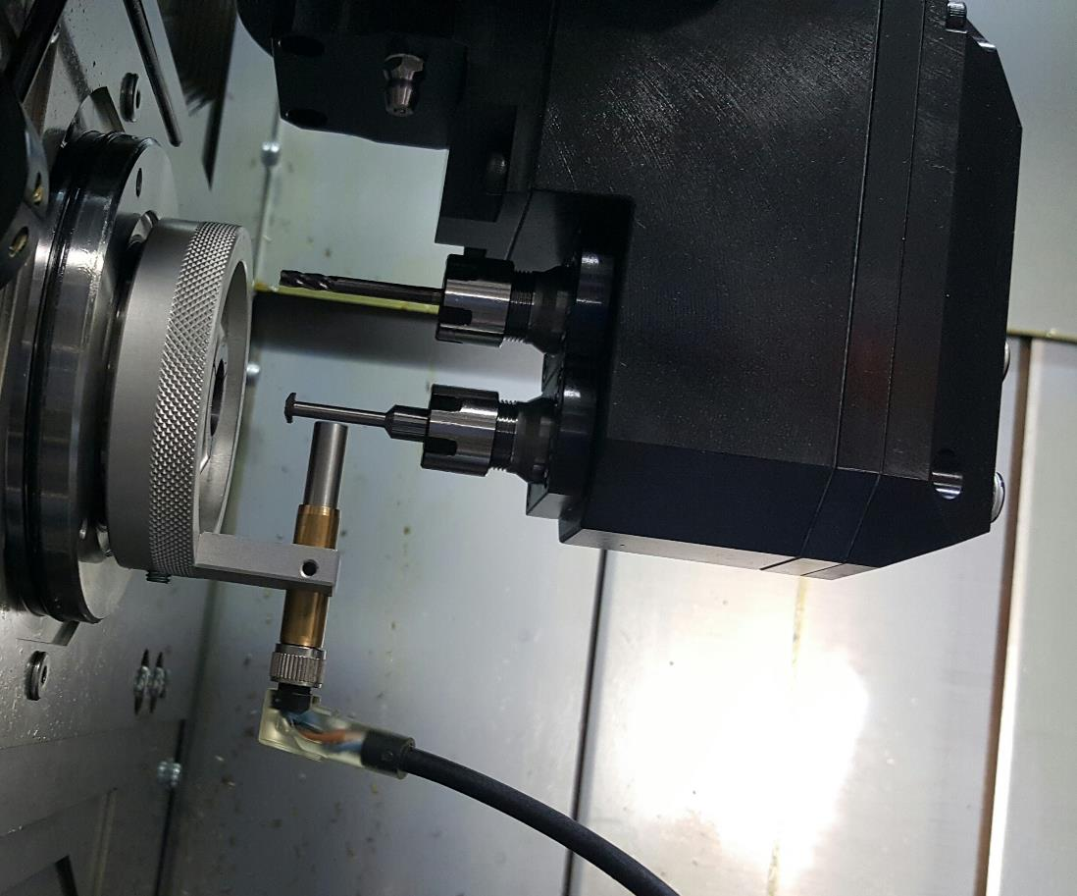
When the vertical centerline has been adjusted as close to 0 as possible, rotate the sensor to the horizontal centerline measuring position.

Slide 15
The display will now show the horizontal deviation from centerline. Move the horizontal axis the full amount to bring it to centerline.

Slide 16
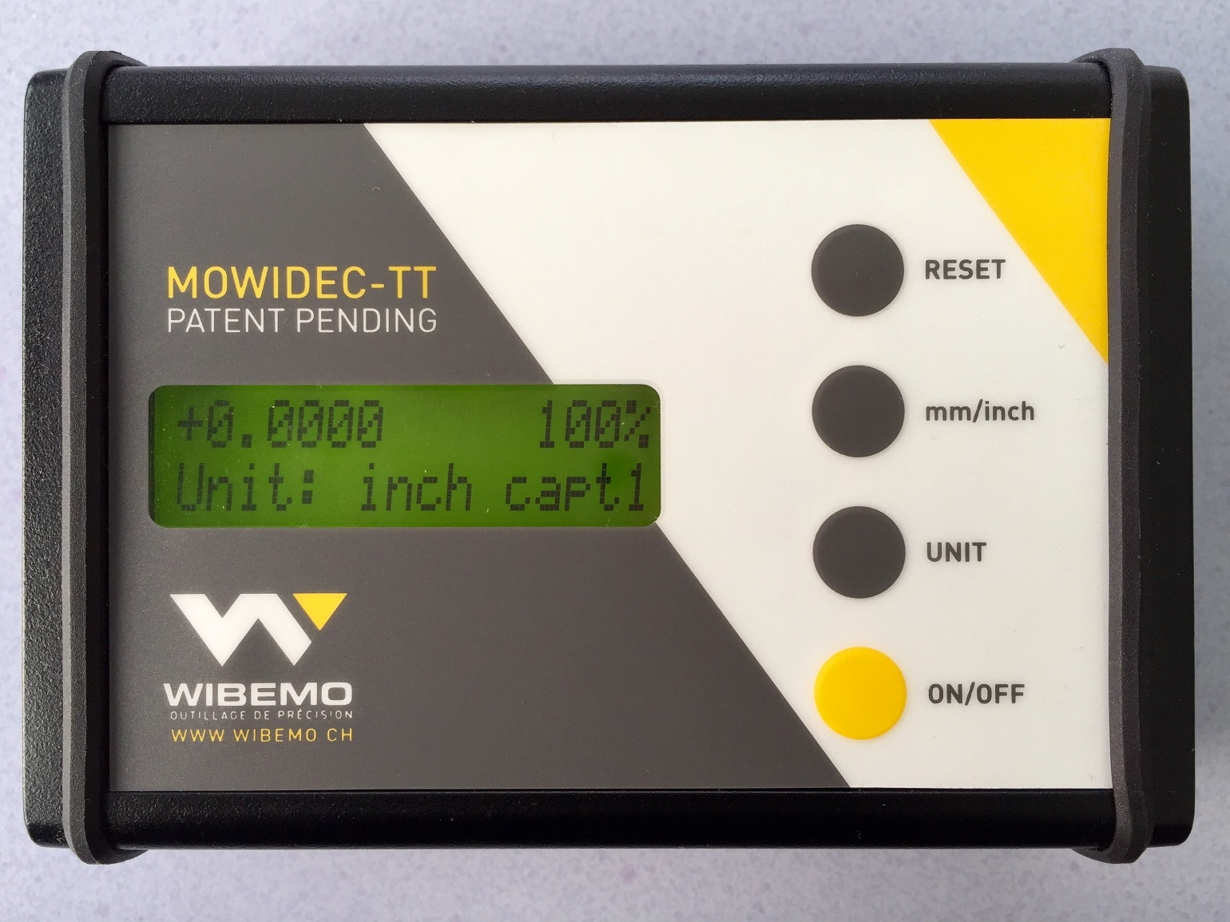
The display shows now the center.

Slide 17
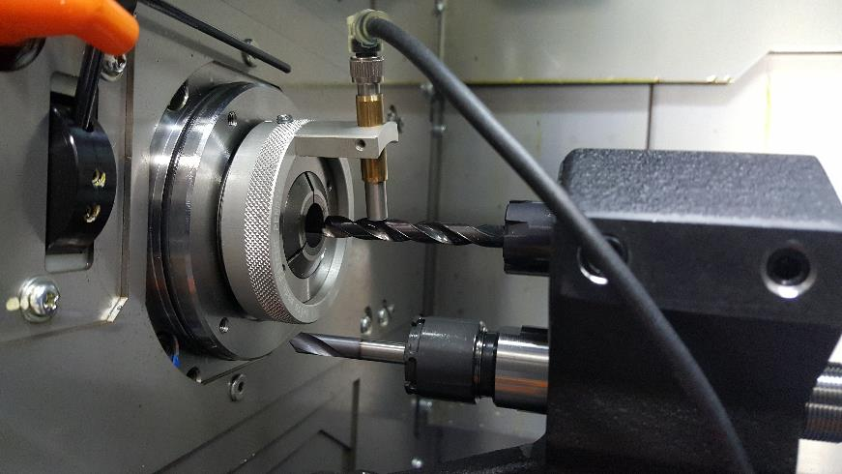
Limitations:
When indicating flutes, erratic readings are given, as would any traditional indicator.
If the tool is not set close enough to the guide bushing that it does not reach out far enough to be under the sensor, it can’t be indicated in this manner without sliding it forward by loosening the sleeve or having a Z3 axis to move toward the sensor.
The display unit needs an AC power supply, so an extension cord will usually be needed.
  Note that the sensor has a cable between it and the display unit. This is very much desired so as to prevent the machine tool door from being closed when the sensor is installed.

Slide 18
Conclusions
As accurate as a traditional .0001” test indicator
Very easy to install and set up in the machine - takes only minutes
Very accurate
Can be installed in positions impossible for traditional indicators to fit, and quickly
Can be transferred from main to sub in minutes
Can check centering and runout
Has a cable from display unit to sensor to prevent door closing, thus preventing inadvertent spindle or tool rotation. (In this case, wireless is not desirable!)

Slide 19

Video of the unit being demonstrated.

